Slide 1
Improving Transparency in Managing Collaborative Research Award in RCM: Linked Fund Numbers
December 2023

Slide 2
Current Structure: Research Accounting
PI Expenditures
ALL expenditures are tracked in PI fund number
Co-PI/Co-I Expenditures
Not separately tracked
All charged to the PI fund number
Indirect Cost Recovery
Credit splits from Coeus are used to allocate IDC recovery to PI and Co-PI(s)/Co-I(s)
Manual transaction
Occurs during the fiscal year after the indirect costs are earned (charged)
Award
Fund Number Created for PI
Co-PI/Co-I related $ embedded within
December 2023
2

Slide 3
Problem
Current fund number set-up for awards does not track Co-PI or Co-I credit
PI/Co-PI/Co-I credit is tied to indirect costs (IDCs) return
Research Community has requested a way to correct so credit is given in a transparent way

Slide 4
Solution
Creation of linked fund numbers for each Co-PI/Co-I tied to the main award fund number (PI's fund number)
Incentivizes research collaboration
IDCs returned in real time
Transparency

Slide 5
New Structure: Research Accounting
Award
PI Fund Number
Co-PI/Co-I (1) Linked Account
Co-PI/Co-I (2) Linked Account
Co-PI/Co-I (3) Linked Account
Etc.
PI Expenditures
PI fund number tied to home org
Co-PI/Co-I linked fund numbers so PI can see all fund numbers
Co-PI/Co-I Expenditures
Linked fund number created for each co-PI/co-I and tied to their home org
Better tracking of individual investigator direct & indirect expenditures
Indirect Cost Recovery
Automatic IDC distribution to proper org
Eliminates credit split report and annual manual journal entry process
December 2023
5

Slide 6
Linked Fund Set-Up Process
Develop Overall budget in Coeus and attach internal spreadsheet identifying linked fund budgets
If awarded, OSP will confirm budgets for each fund
OSP requests RAS to set-up new fund # for the main fund and all linked funds
RAS sets up the main fund and linked funds with the budget breakdowns provided by OSP
RAS completes set up for the main fund and all linked funds
A confirmation email will be sent to the PI/co-PI/Is and department administrators of all fund #'s created.
December 2023
6

Slide 7
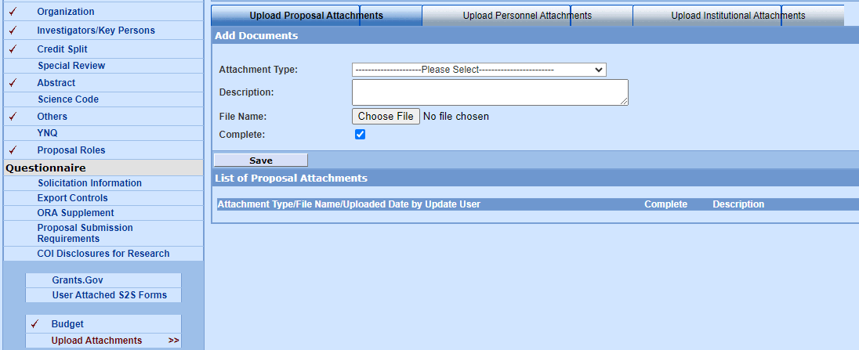
Changes at Proposal Stage in Coeus
Upload budget template in the “Upload Attachments”: “Upload Institutional Attachments” Section
Budgets will include PI and co-PI/co-Is, org code(s) and budget(s) by account code for the main fund number and each linked fund number
December 2023
7

Slide 8
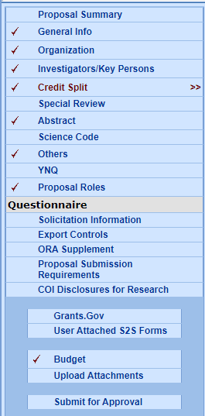
Changes at Proposal Stage in Coeus
The Credit Split tab will no longer be necessary as this has been previously used to distribute IDCs.
IDCs will be distributed based on each fund number’s indirect costs charged
December 2023
8

Slide 9
Changes at Award Stage
Grants Administrator will contact PI and Department Administrator to confirm the budget for the award period
Grants Administrator will provide the original budget template provided at the proposal submission
PI, with assistance from Department Administrator, will make any necessary budget revisions
The budget in the main fund number + the budgets in all linked funds = total amount awarded by sponsor
PI, or Department Administrator with confirmation from the PI, will submit the corrected budget to the Grants Administrator
Grants Administrator will provide RAS the budget template with all budgets for the main fund number and associated fund numbers to be created
December 2023
9

Slide 10
Changes at Each Notice of Award
For Multi-Year Projects with NOAs for each year, follow the same process as initial award set-up:
Grants Administrator will contact PI and Department Administrator to confirm the budget for the award period
Grants Administrator will provide the original budget template provided at the proposal submission
PI, with assistance from Department Administrator, will make any necessary budget revisions
The budget in the main fund number + the budgets in all linked funds = total amount awarded by sponsor
PI, or Department Administrator with confirmation from the PI, will submit the corrected budget to the Grants Administrator
Grants Administrator will provide RAS the budget template with all budgets for the main fund number and associated fund numbers to be created
RAS will either create additional link fund numbers, if needed, or update the budgets of each fund number of the original award set-up
December 2023
10

Slide 11
Budget Changes Outside of NOAs
PI, or Department Administrator with confirmation from the PI, will submit the corrected budget to RAS via fundnumber@drexel.edu
If a Co-PI or Co-I wants to change their budget, an email from the PI approving the change will be required in order to change budgets within the linked fund numbers
Ensures PI is the one fiscally responsible for the budget changes and the changes are allowed by the sponsor and meet the aims of the project
December 2023
11

Slide 12
Timeline of Transition
Effective Date: Proposals submitted on or after January 1, 2024
Transition period for proposals submitted in Coeus
For proposals submitted January 1 – February 29, 2024, if a budget template is not attached to the Coeus record, a budget template will be required at award set-up
Beginning March 1, 2024, a budget template will be mandatory at the proposal stage
If it is not attached, a Grants Administrator will recall the Coeus Record
December 2023
12

Slide 13
Resources
Resources will be posted on ORI’s website:
Budget Template
FAQs
Recording of today’s training
Guidelines and Procedures
Reminders will be sent in the ORI newsletter and disseminated through ADRs, the University Research Council, and RAAC
December 2023
13

Slide 14
FAQs
Is a PI tied to the budget provided at the proposal stage?
No. The proposed budget may be change at time of award as long as it does not change the SOW and is being corrected in order to meet the aims of the project or to make adjustments due to a different award amount.
Can a Co-PI/Co-I make changes to their linked fund number budget?
Yes, a Co-PI/Co-I may make changes to their linked fund number as long as they have discussed the proposed changes with the PI and the PI approves
December 2023
14

Slide 15
FAQs
What if I want to provide more IDCs to one of my Co-PIs/Co-Is on the project?
If a PI decides to return more IDCs to others listed on the project, this can be completed through a journal entry after the PI has discussed with his/her department
Can a linked fund number be created for other senior key personnel listed on a project?
Linked fund numbers will be restricted to set up only for other Co-PIs or Co-Is listed on the project
Other senior key personnel will be listed on either the main fund number or a linked fund number
If the PI wants to provide IDC returns to a senior key personnel without a linked fund number, a journal entry will need to be created after the PI has discussed this request with his/her department
December 2023
15

Slide 16
Contacts
Office of Sponsored Programs
Proposal submissions, COEUS records, and budget breakdowns at proposal or award stage for main and linked funds
OSP: DUResearch@drexel.edu
Research Accounting Services
Banner set-up of new main fund and linked fund numbers or changes of a budget within Banner
RAS: fundnumber@drexel.edu
Evelyn Balabis, Executive Director, Research Accounting Services: eb545@drexel.edu
Sarah Saxton, Executive Director, Sponsored Programs: sms559@drexel.edu

Slide 17
Questions?

